Slide 1
Environmental Guidance in Digital Games: Influencing Player Navigation Without Explicit Instruction
Morgan Hodge

Slide 2
Research Question
Which environmental design techniques are most effective at influencing player navigation and decision making without explicit guidance systems?

Slide 3
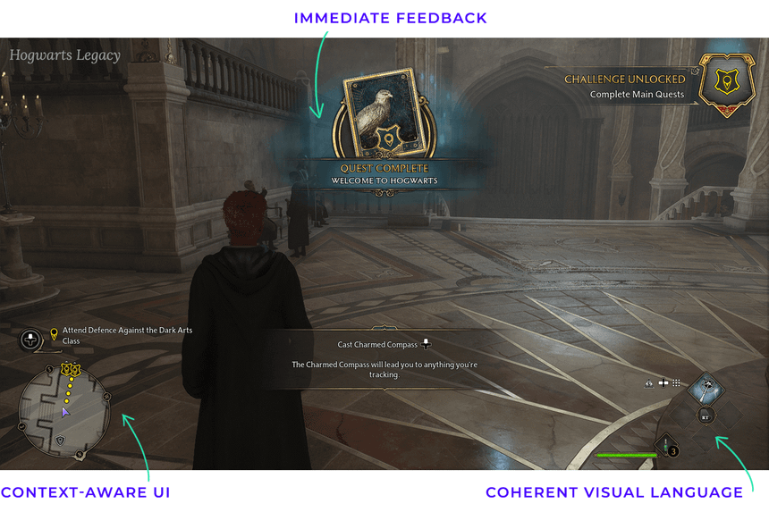
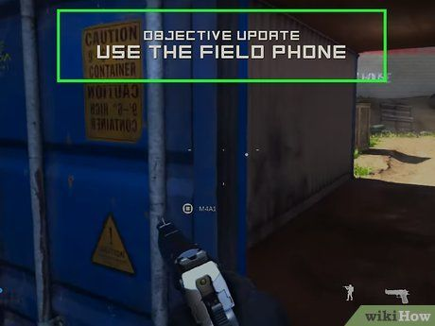
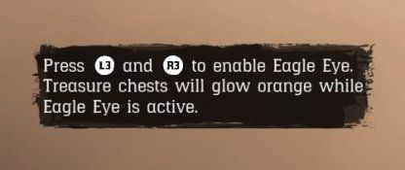
Context of my project
The Problem
Players need guidance to navigate game worlds
Traditional guidance systems include:
Quest markers
Mini map indicators
Tutorial Prompts
Coloured assets
While these traditional methods are effective, they can reduce immersion and player discovery

Slide 4
How does it fit into my specific field
Design
Level Design
Wayfinding
Technical Design (Prototyping)
Environmental Storytelling
Player Psychology
Environmental Design
Player Attention
Navigation Decisions
Player Experience

Slide 5
Existing Research & State of the art
Academic Sources
Wayfinding research
Cognitive maps
Environmental cues
Industry sources
Totten
GDC talks
Extensive list of videos, books, and educational articles are listed in my proposal form

Slide 6
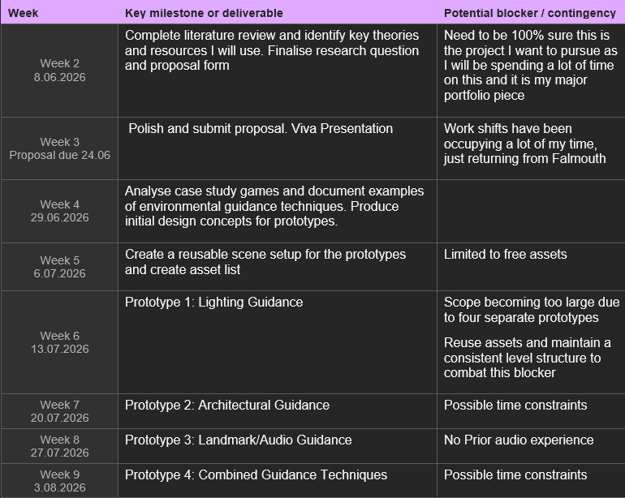
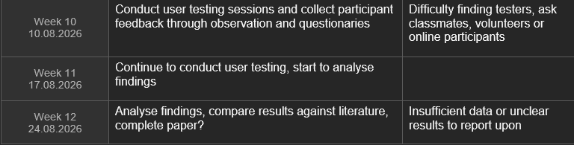
Artefact
Title - Environmental Guidance in Digital Games: Influencing Player Navigation Without Explicit Instruction
TimeLine
Primary Artefact:
4 Unreal Engine Prototypes
Prototype 1 - Lighting
Prototype 2 – Architectural
Prototype 3 – Landmark/Audio
Prototype 4 – Combined Techniques
Supporting Artefact:
Research Blog/ development vlog

Slide 7
Research & Development Approach
Literature Review
Contextual Review
Prototype Development
Playtesting
Analysis
Recommendations

Slide 8
Who is the project for?
Myself and Future Employers
Portfolio piece showcasing Technical Design, Level Design , and System Design
Demonstrates my design process and research abilities
Secondary Audience
Game and Level Designers
Indie studios without designated designers

